Slide 1


Submitted in the partial fulfillment for the award of the degree of
BACHELOR OF ENGINEERING
IN
CSE-BIG DATA ANALYTICS
Submitted by:
STUTI SRIVASTAVA - 19BCS3834
SHIVANI KUMARI - 19BCS3839
AMAN SHARMA - 19BCS3859
PRERNA KHANDWAL - 19BCS3860
Under the supervision of:
Dr. Shikha Gupta

Slide 2
CORONA VIRUS OUTBREAK
NOTIFICATION SYSTEM
Runtime Terror Group

Slide 3








Outline
Introduction to Project
Problem Formulation
Objective of the work
Methodology used
It is a Notification System.
It gives information about COVID-19 cases in states of India.
Cases are increasing rapidly.
It is a need to save the time of user to directly access the cases.
Neat, clean and simplified transfer of information.
Save time to one-click.
Web-scraping to extract the data and notifier to show data.
Results and Outputs
Conclusion
Future Scope
References
Result and Output are attached.
Notification system is working fine and showing the number of Recent Active, total, cured cases and deaths.
This section contains the improvement which can take place.
Resources, guide and information, we used to develop the system.

Slide 4

Introduction to Project
It is a customized desktop notification system utilizing python.
This notification system shows COVID-19 current no. of active cases and deaths of a particular state.

Slide 5
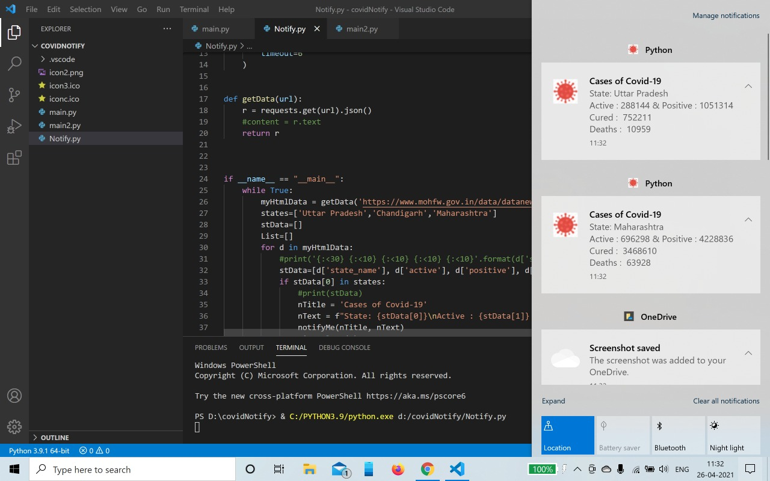
We actually want to utilize distinctive python libraries to get information from the web, measure the information, and present the information as notification.

Slide 6
Problem Formulation
Visual studio code
We have used this because it gives us various functionality and simplified interface.
Requirements:
1.8 GHz or faster processor, Quad core or better recommended.
2 GB of RAM; 8 GB of RAM recommended.
Hard disk space: Minimum of 800 mb up to 210 GB of available.
Internet Connection
Plyer
As this is the work area notifier application, we will utilize the plyer module in our program.

Slide 7

Json File
Json is javascript object Notation. The executable file which is made of text in a programming language is used to store and transfer data.
App Icon
Type of file – ICO File(.ico)

Slide 8
Objectives
Because of the new corona virus outbreak in China, tracking the spread of the virus has been a key factor in understanding the severity of the problem. So, we created a desktop notification system to know the gradual rise in the number of cases without searching into the internet.
The desktop version is more user friendly as you all can see all the key numbers in one window.

Slide 9
Methodology used
The following methodology will be followed to achieve the objectives defined for proposed research work:
Detailed study of python programming language and various modules like plyer, time, etc will be done in our program.
Installation and hand on experience on existing approaches of plyer module will be done.
Relative pros and cons would be taken into consideration.

Slide 10
Various modules like results, plyer, time, bs4 are being used.
The above mentioned modules do not come built-in with python. To install it externally, we need to write the following command in our terminal:
pip install ‘module_name’ example: pip install plyer.
Various parameters will be identified to evaluate the proposed system.
Comparison of new implemented approach with exiting approaches will be done.

Slide 11
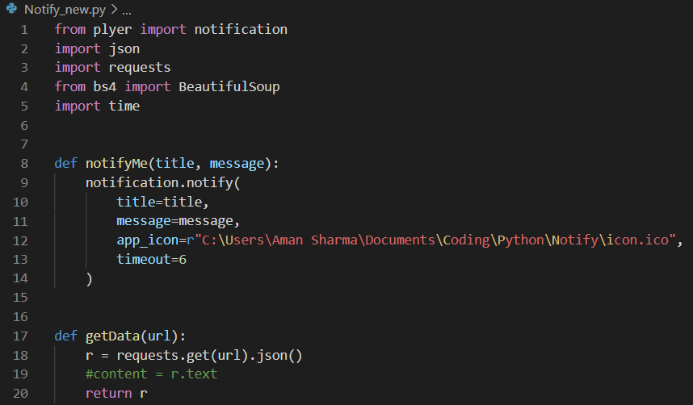
CODE

Slide 12
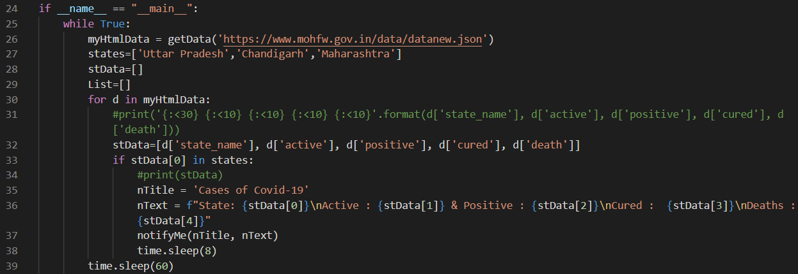

Slide 13
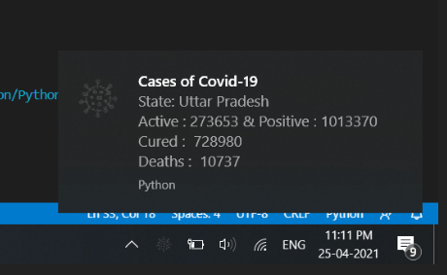
RESULT/OUTPUT
1. Status of Uttar Pradesh

Slide 14
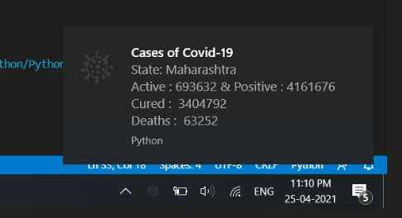
2. Status of Maharashtra

Slide 15
Conclusion
Our project is about getting a notification after a particular time interval about active, positive and cured COVID-19 patients.
As we know Python is a script-based programming language. If we want to run our program, we can’t do it directly. We have to copy paste source code every single time we want to run our program. In order to overcome this drawback user, need to download one module name “pyinsataller”.

Slide 16
Future Scope
In the code we need to mention the particular state to fetch the data. But it won’t be same in future. This project will prove to be a life saver for those who are always running short of time and need to get update quickly.
Little modification in this would be really beneficial.
And not just for corona, rather we can use this system to view updates of any disease or something by linking it with a different website.

Slide 17
References
https://www.worldometers.info/coronavirus/country/india/
https://www.mohfw.gov.in/
https://healthitanalytics.com/news/understanding-the-covid-19-pandemic-as-a-big-data-analytics-issue
https://www.who.int/data/data-collection-tools
https://www.biomedcentral.com/collections/COVID19-research-methodology
https://ourworldindata.org/coronavirus-source-data

Slide 18

Thank You

